Slide 1

AQUAVIEW+ : Cloud Enabled Data Assembly and Dissemination System

Slide 2


Statement of Need: NOAA Fisheries Data Management
NOAA Fisheries Needs:
Improving independent understandability and interoperability across NMFS as data are collected and managed in unique formats and variables
Appropriately handling and providing access to commercially sensitive or PII data
Ability to handle multi-source data streams
Meeting FAIR Standards to improve findability, accessibility, integration, and reusability across the NOAA data enterprise and beyond
Providing a common data framework across the NOAA data enterprise
2

Slide 3
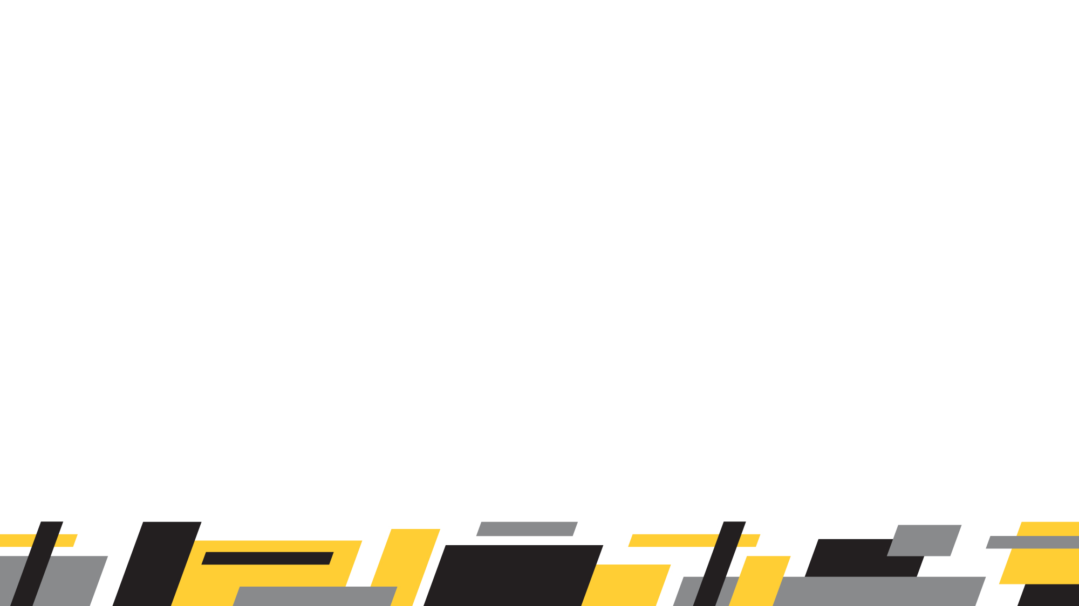
Objective
Objective: To rapidly transform NOAA’s infrastructure and tools for archive, access, and usability of ocean data and unlock the full potential of past and future observations.
The Initiative will build off AQUAVIEW’s existing federated platform to fully leverage the cloud, resulting in expanded use of NOAA data in critical decision support contexts from climate adaptation to ecosystem resilience. With centralized access to NOAA Fisheries petabyte-sized holdings of data, scientists and resource managers will be able to more comprehensively and more quickly find and take advantage of disparate data for report generation, analysis, and other needs as identified as the Data Assembly Hub comes online.
3

Slide 4
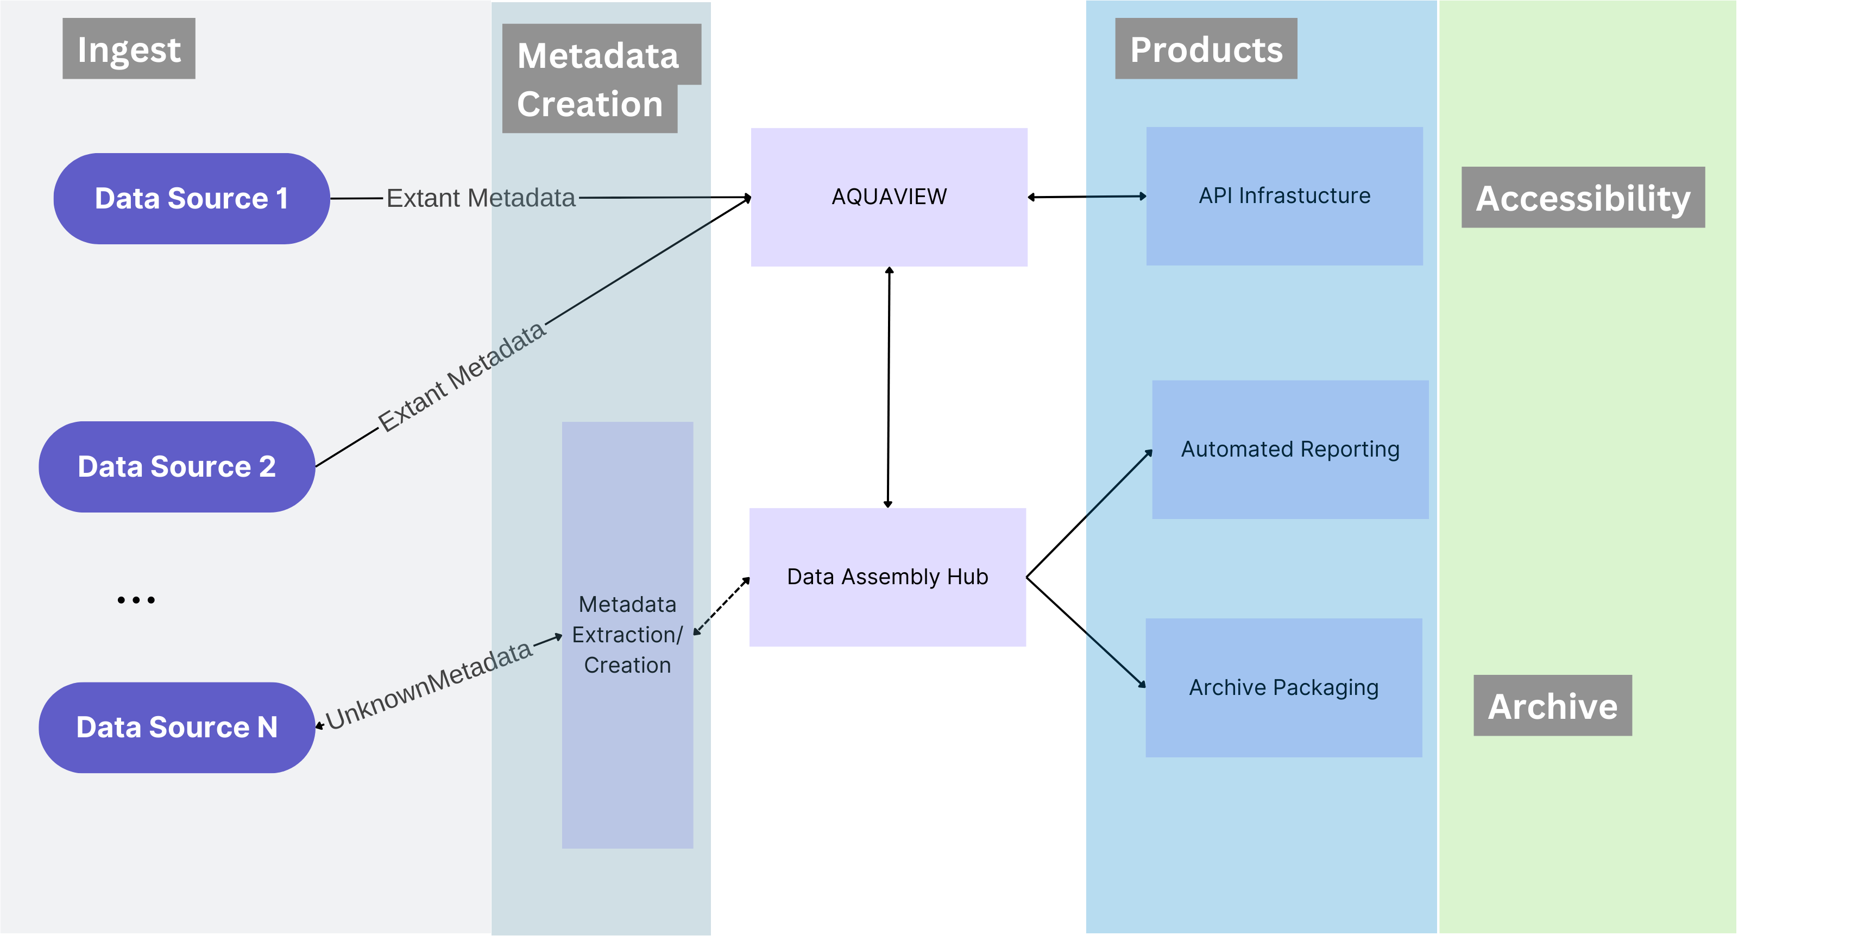
Two Components
AQUAVIEW
Prototype system developed as a metadata aggregator and API ecosystem for NOAA data
Uses S3 as data repository with MongoDB as metadata library
Proven system looking to expand data for testing and use
Data Assembly Hub
System beginning development in September 2023
Will provide repeatable data pipelines for report/archive package generation
Will operate with AQUAVIEW as metadata repository
Will generate metadata on ingest and provide AI ready data for use via AQUAVIEW’s API ecosystem

Slide 5
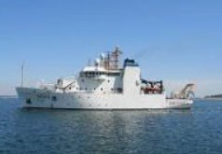
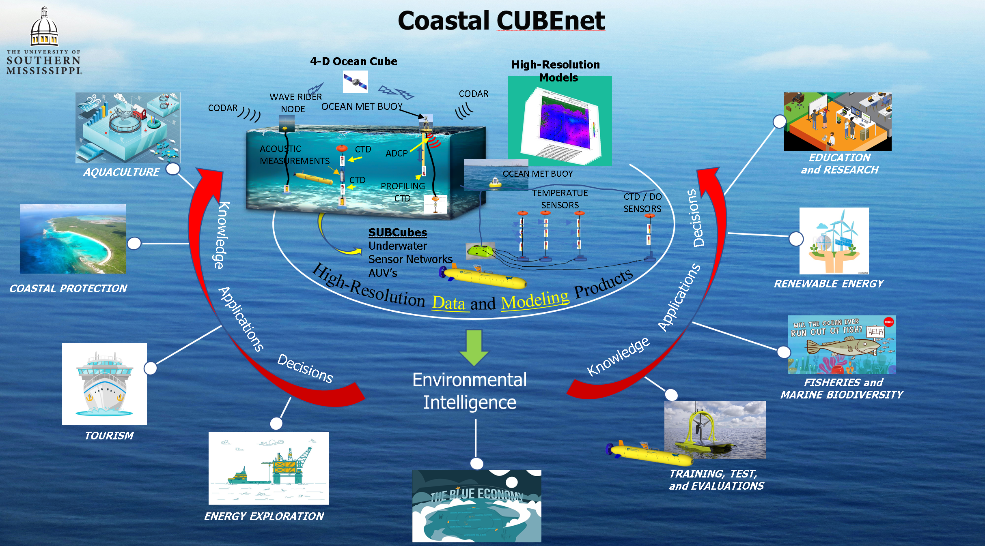
AQUAVIEW’s Current Data Delivery Model
(Also works with other cloud-based systems)
S3
(AWS)
Upload Methods
Near RT Uploads (OceanCube)
Older Data Ingestion
Federated Data
Meta Data Compilation and Access
AQUAVIEW API
Archiving
AQUAVIEW
External Partners
API’s allow for search GUI development and will allow scientists to build their own tools
External academic partners can use the uploaded data and metadata to initialize and/or ground-truth their regional ocean models or join with other data
Upcoming Data Assembly Hub work will allow for automated report generation/archive package development/deployment

Slide 6

AQUAVIEW
Set of Python Applications/MongoDB for metadata storage coupled with federated cloud-based data
Collects and merges metadata from current operations or previously generated data
Can provide at or near-real-time support for data collections
Has API system to enable access from outside organizations with ability to limit data access via “tags” on specific datasets/types/etc.
Can enable purpose-built applications from database

Slide 7
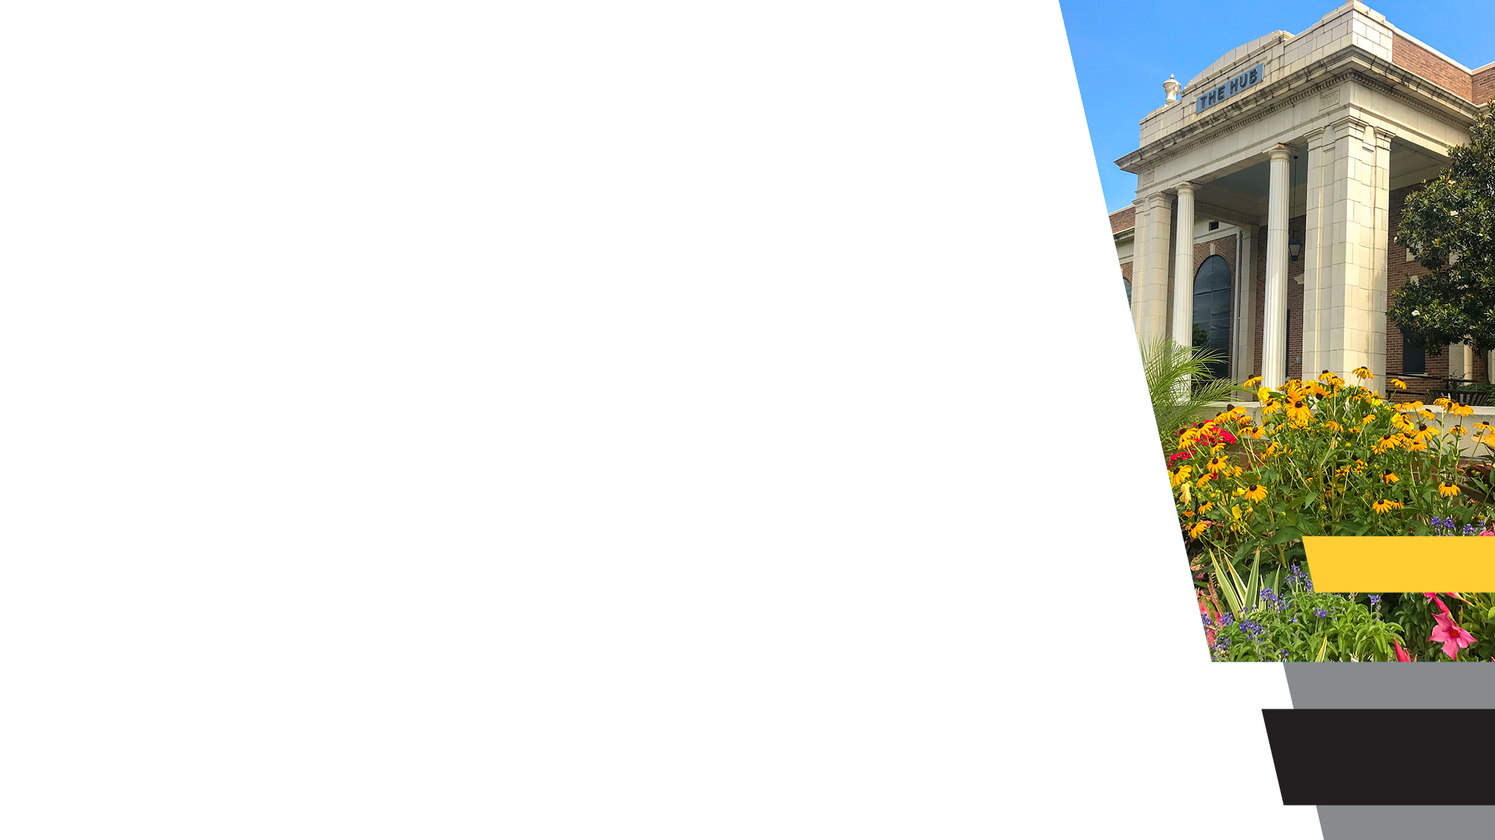
Data Assembly Hub (Development starting Fall 2023)
Will provide for automated metadata extraction
Reproducible data pipelines (including data transformations, etc.) for report generation or other analyses
Git style change tracking to lower storage overhead
Formats/QC metadata for joining into the larger data system
Data access can be controlled via “tags” within the data system
Works with AQUAVIEW API system
Will allow for custom archive format script development for automation of archiving data

Slide 8

Initial Outcomes
AQUAVIEW+Data Assembly Hub will create a platform that achieves the following goals:
Demonstrate and learn how a federated cloud archive could be used to improve timely, efficient, and consistent access of data for broad use
Leverage cloud-based workflows to improve production of decision support tools, including ingestion, metadata creation, product development, archival packaging and accessibility
Build API ecosystems for use by scientists and other interested parties to develop products from NOAA Ocean Data
Create system where near-real-time feedback can be provided for data collection operations underway in a variety of environments

